Slide 1


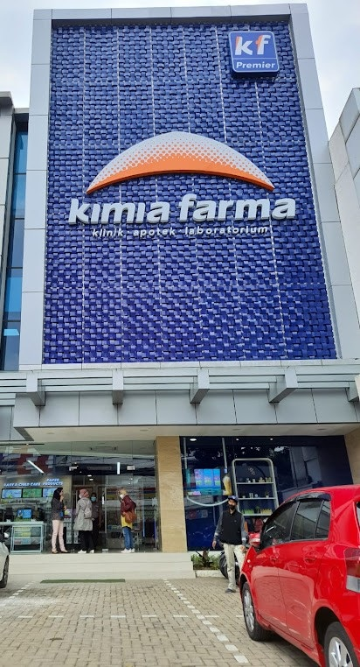

X
Performance Analytics
Business Year 2020-2023
Kimia Farma - Big Data Analytics
Presented by
Intan Auliya
www.rakamin.com

Slide 2
Table of Contents
1
About Me
6
Analysis Table
2
Courses & Certification
7
BigQuery Syntax
3
About Company
8
Dashboard
4
Project Portfolio
9
Recommendation
5
Importing Dataset
10
Links

Slide 3





1
About Me
Hi! I’m Intan
Data Enthusiast | Mathematics Educator
I aspire to be a Data Analyst that highly value responsibility for my actions and my work. Committed to improve and sharpen my technical skills in solving problem with statistical approaches. My goal was to provide insight from a real-time data for business strategies and to improve work efficiency while expanding data analysis project.
Surabaya, Jawa Timur
intanauliya84@gmail.com
https://www.linkedin.com/in/intanauly/

Slide 4
2
Courses & Certification
Exploratory Data Analysis
https://academy.dqlab.id/Certificate_check/result/DQLABINTP1QJGMNM Jun, 2022 Mempelajari Cara Menganalisa Data untuk Analis Database
https://img-certificate.ruangguru.com/AULIYAIFF05CKYJI/CERT-1RMZVNP1 Nov, 2022

Slide 5

3
About Company
In 1817 it was founded by the Dutch East Indies Government as the first pharmaceutical company in Indonesia. Initially named NV Chemicalien Handle Rathkamp & Co
It was nationalized in 1958 and renamed PNF Bhinneka Kimia Farma. In 1971, the company transitioned to PT Kimia Farma (Persero) and became a publicly listed company, PT Kimia Farma (Persero) Tbk in 2001
In 2014, Kimia Farma became heathcare company.
PT Kimia Farma Tbk
(2020-now)
is a state-owned company (BUMN) which is play a role in national health development
In 2020, 90,025% of Kimia Farma’s shares were transferred ownership to PT Bio Farma (Persero). Along with this restructuring, the company’s name changed to PT Kimia Farma Tbk
www.kimiafarma.co.id

Slide 6

Project Portfolio
4
Background :
As a Big Data Analytics Intern at Kimia Farma, I was given the task to evaluate business performance from 2020 to 2023 using data-driven insight.
Dataset :
kf_final_transaction.csv (link) : customer transaction details
kf_inventory.csv (link) : product inventory stock
kf_kantor_cabang.csv (link) : branch store details
kf_product.csv (link) : product details
Problem :
Import dataset and create analysis tables by aggregating data from the imported tables using Google BigQuery
Create a performance analysis dashboard for Kimia Farma business year 2020-2023 using Google Looker Studio
Notes:
Project explanation video here!
<buat hyperlink di kata "here" di atas, sisipkan link youtube yang berisi rekaman anda melakukan presentasi penjelasan hasil pengerjaan final task.

Slide 7
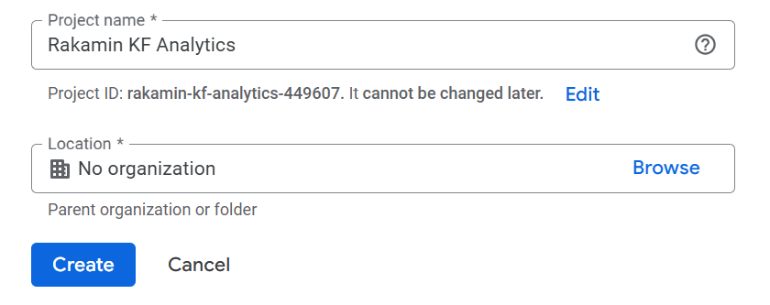

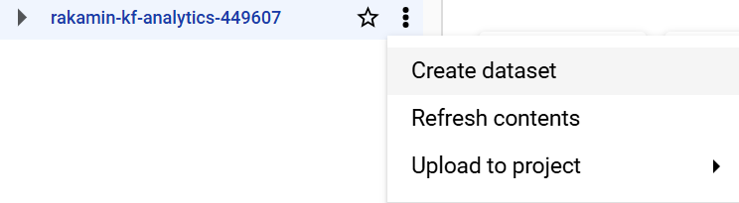
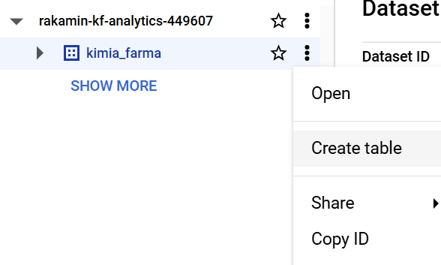
Importing Dataset
5
1. Create a new project in BigQuery with a name “Rakamin KF Analytics”
2. Create a new dataset with the name “kimia_farma” inside the project “Rakamin KF Analytics”

Slide 8
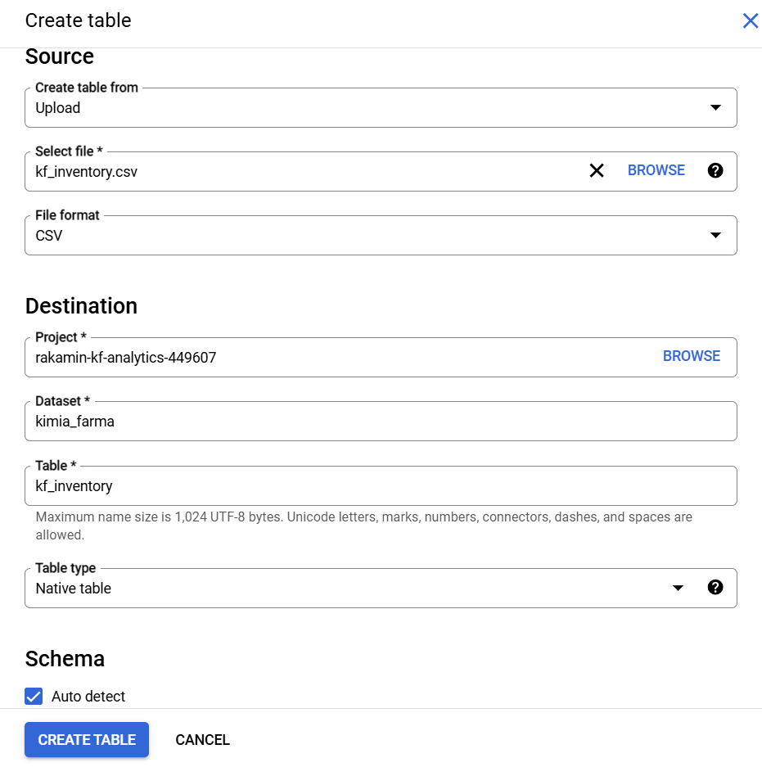
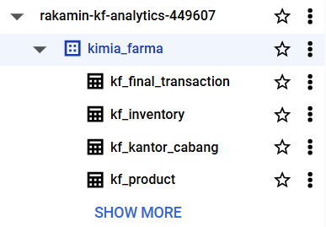
Importing Dataset
5
3. Complete the requested task : import the provided datasets into BigQuery as tables and use the dataset
names excluding the “.csv”

Slide 9
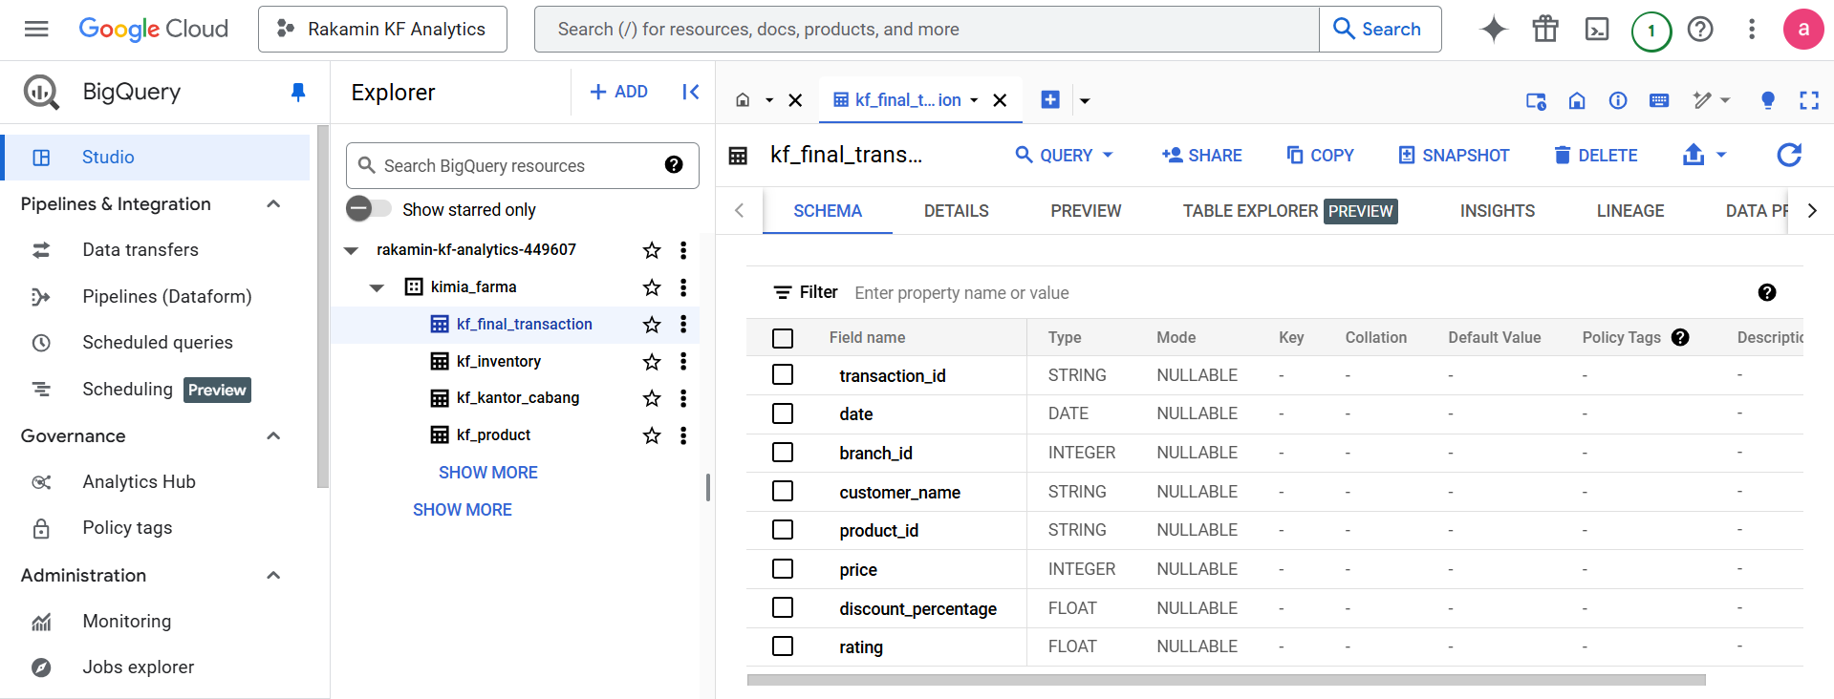
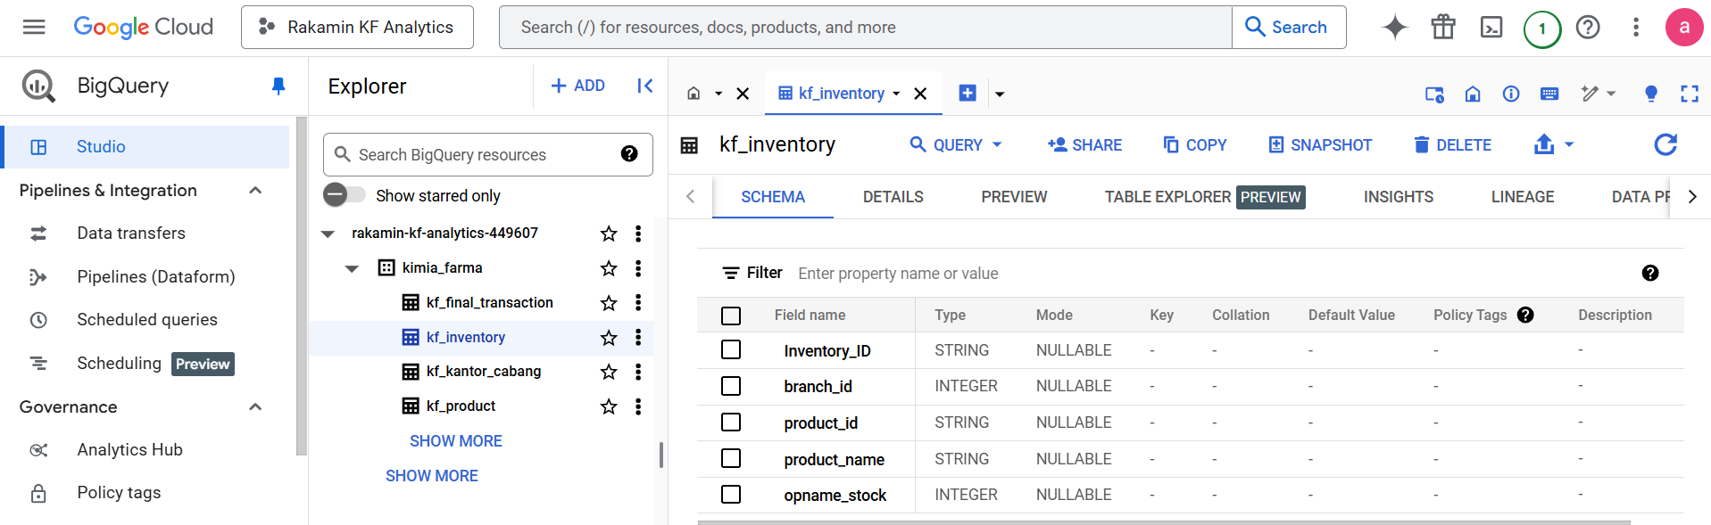
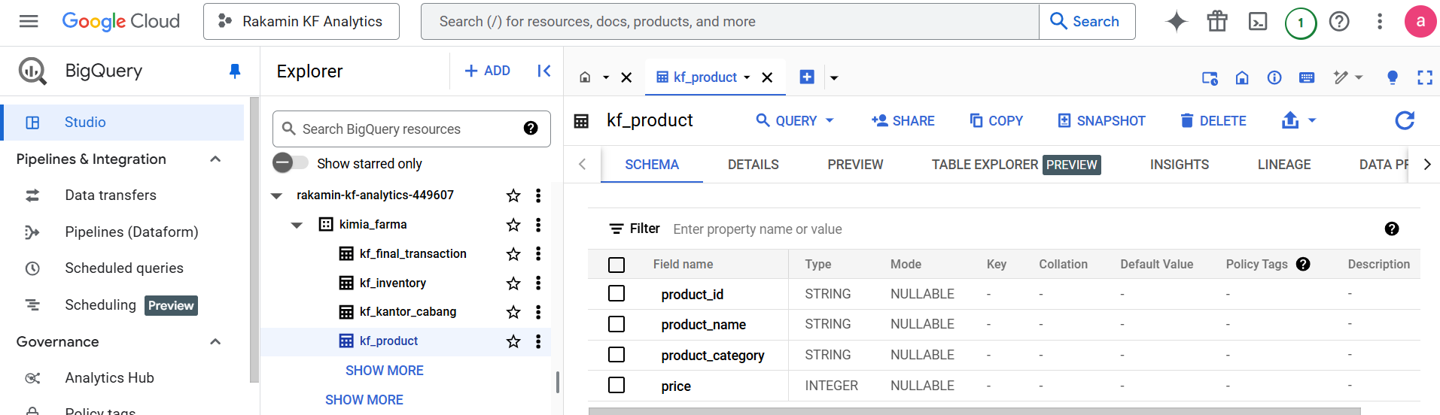
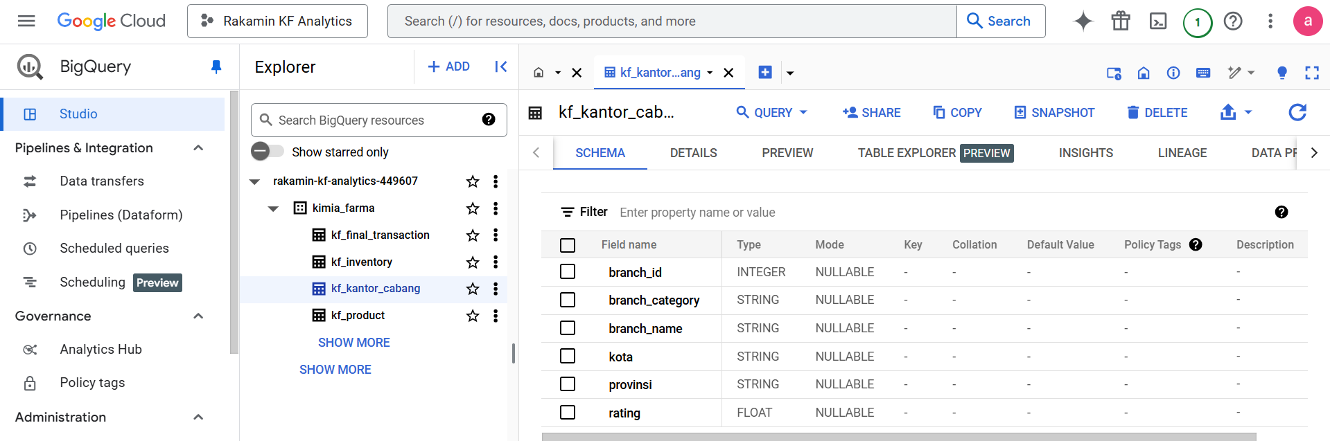
Importing Dataset
5
4. Check data quality (missing value or duplicate)

Slide 10
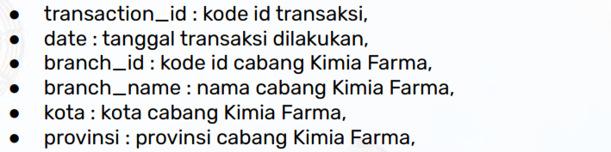
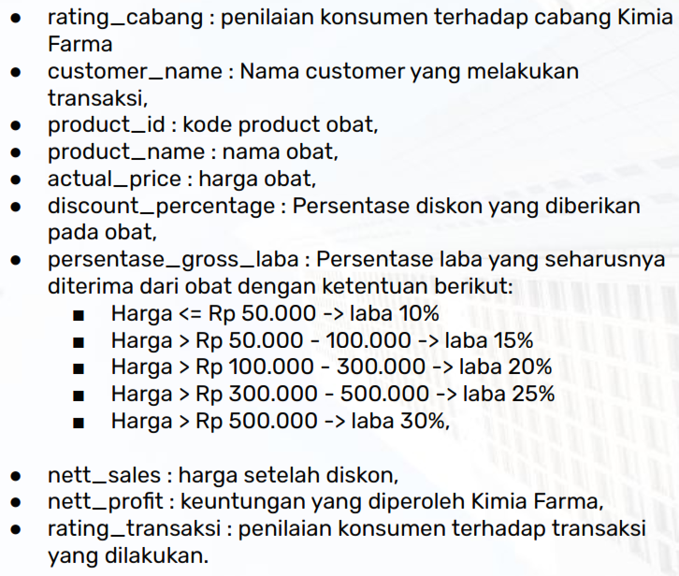
Analysis Table
6
Create an analysis tables by aggregation data from the four previously imported tables with the following conditions

Slide 11
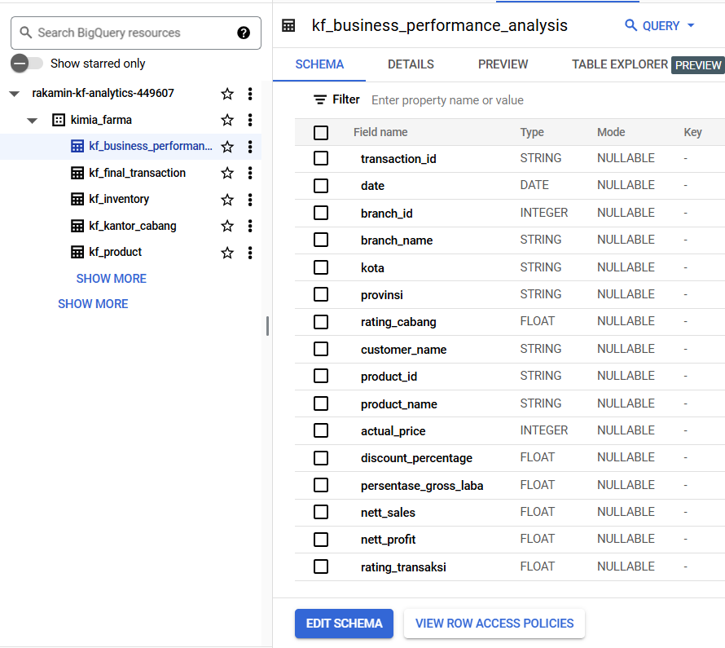
Analysis Table
6
Create a new analysis table named kf_business_performance_analysis using the CREATE TABLE statement.
Filled in data for the new table using the SELECT query for retrieve data from the previously imported tables (kf_final_transaction, kf_inventory, kf_kantor_cabang, kf_product).
Connect the tables to each other using INNER JOIN query.

Slide 12
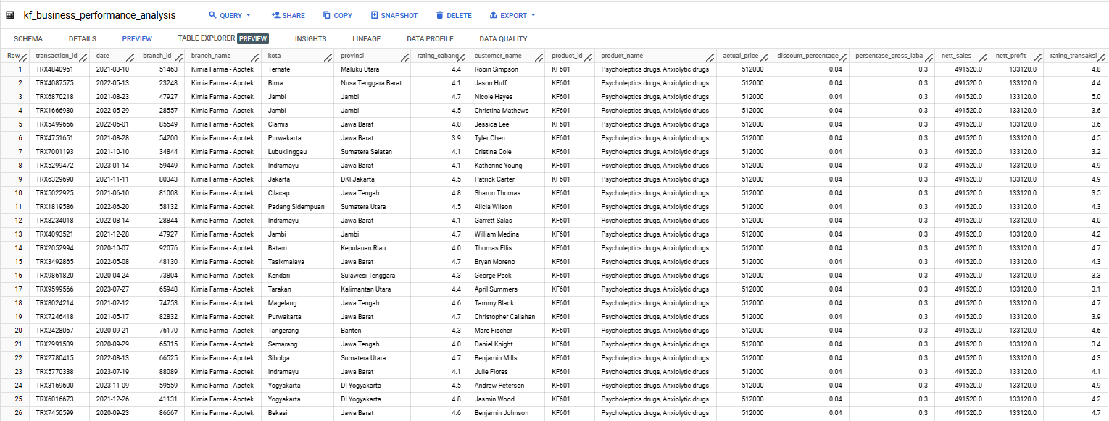
Analysis Table
6
The query result data has a total of 16 columns

Slide 13
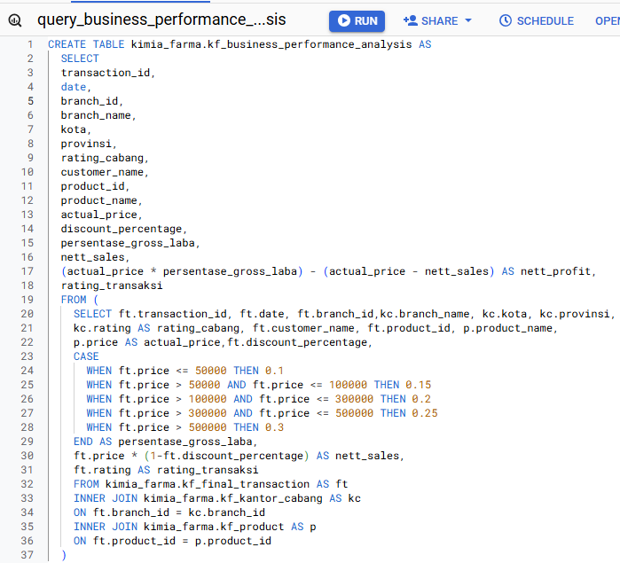
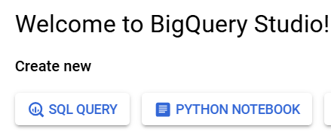
BigQuery Syntax
7
>
Link

Slide 14
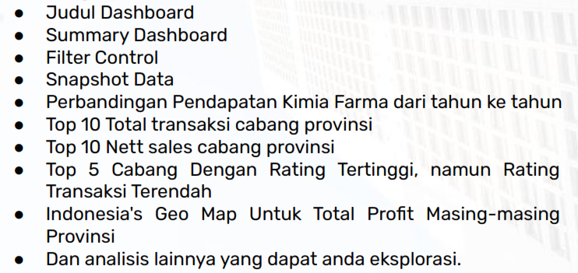
Dashboard
8
Create a performance analytics dashboard for Kimia Farma business year
2020-2023 using Google Looker Studio with the following conditions

Slide 15
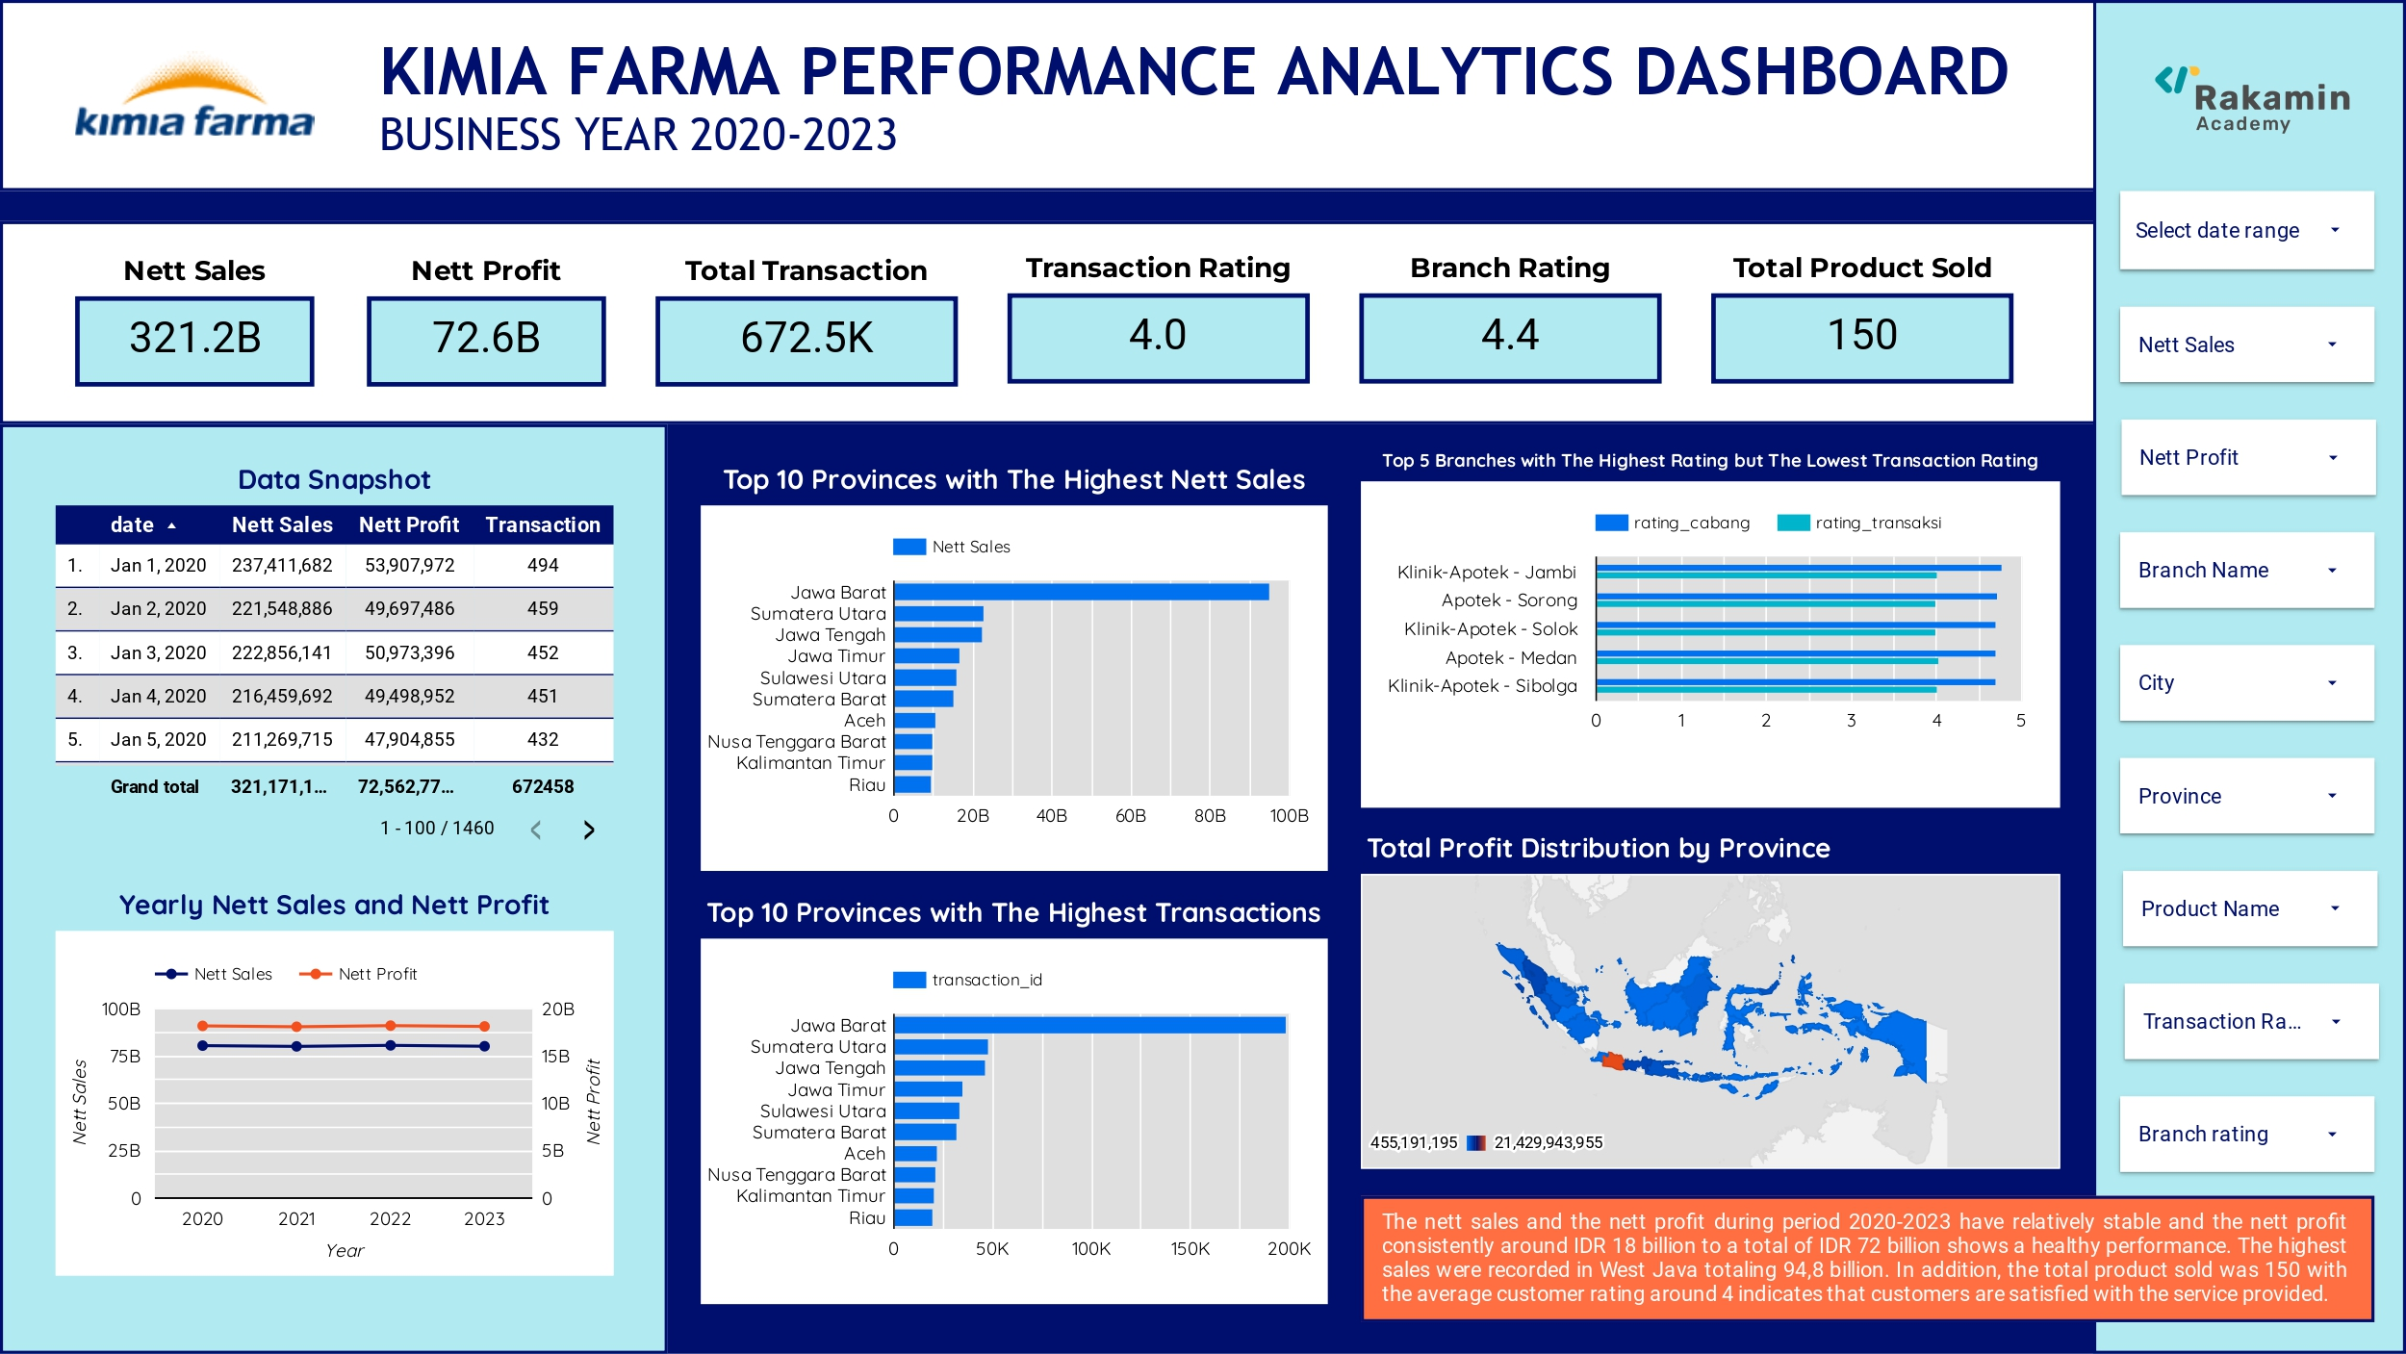
Dashboard
8
Link

Slide 16
Dashboard Performance Analytics
A calculated field has been added to the table to make it easier to display the chart of top 5 branches with high ratings but low transaction ratings.
CASE
WHEN branch_name = 'Kimia Farma - Apotek' THEN CONCAT('Apotek - ',kota)
WHEN branch_name = 'Kimia Farma - Klinik & Apotek' THEN CONCAT('Klinik-Apotek - ',kota)
WHEN branch_name = 'Kimia Farma - Klinik-Apotik-Laboratorium' THEN CONCAT('Klinik-Apotek-Lab - ', kota)
END
Interpretation :
The nett sales and the nett profit during period 2020-2023 have relatively stable and the nett profit consistently around IDR 18 billion annually, totaling IDR 72 billion shows a healthy performance.
The total number of transactions reached 672,5 thousand shows an active and growing business activities.
The average customer rating is 4 indicates that customers are satisfied with the service provided.
The total product sold was 150 product codes with a very high transaction volume means that product diversity was received well by the market

Slide 17
PENDAHULUAN
LOKASI
Recommendation
9
The highest sales distribution during the 2020-2023 period were recorded in West Java with 94,8 billion, followed by North Sumatra with 22,9 billion in second place. This is a great potential for expanding sales and marketing outside Java.
>
In several branches, recorded the highest customer ratings was the lowest transaction. This indicates that customer are satisfied with the services but not the transaction. It is recommended to improve the product, add product variations, and improve branch accessibily.
>

Slide 18
10
Links
Looker Studio Dashboard
https://lookerstudio.google.com/reporting/1bfea5d2-5886-4f5a-ad90-12cefea7df53 Presentation Video
https://drive.google.com/file/d/1F2TOVHvIPYknROqDrZqQKED_mGbPEhdz/view?usp=sharing Github Repository
https://github.com/intanauliya/performance_analytics-PBI-Kimia-Farma

Slide 19
THANK YOU
X

